Slide 1
Refining the Shared Framework for
Model Element Reuse
By: Paul Trevidic and Michael Pennock
27th Annual NDIA Systems and Mission Engineering Conference
October 31, 2024

Slide 2
Introduction
MITRE sponsors are pursuing Mission Engineering (ME) as a means to address their rapidly evolving challenges
  Digital engineering is used to enable these efforts
Short cycle times preclude repeated development of models from scratch
The Shared Modeling Framework was developed to mitigate this issue
  Based on experimentation to determine the appropriate approach to reuse over multiple, real-world Mission Engineering efforts
In the following slides, we’ll discuss the history of the Shared Modeling Framework, the approach, its benefits, how we updated it using an open standards approach, and its future

Slide 3
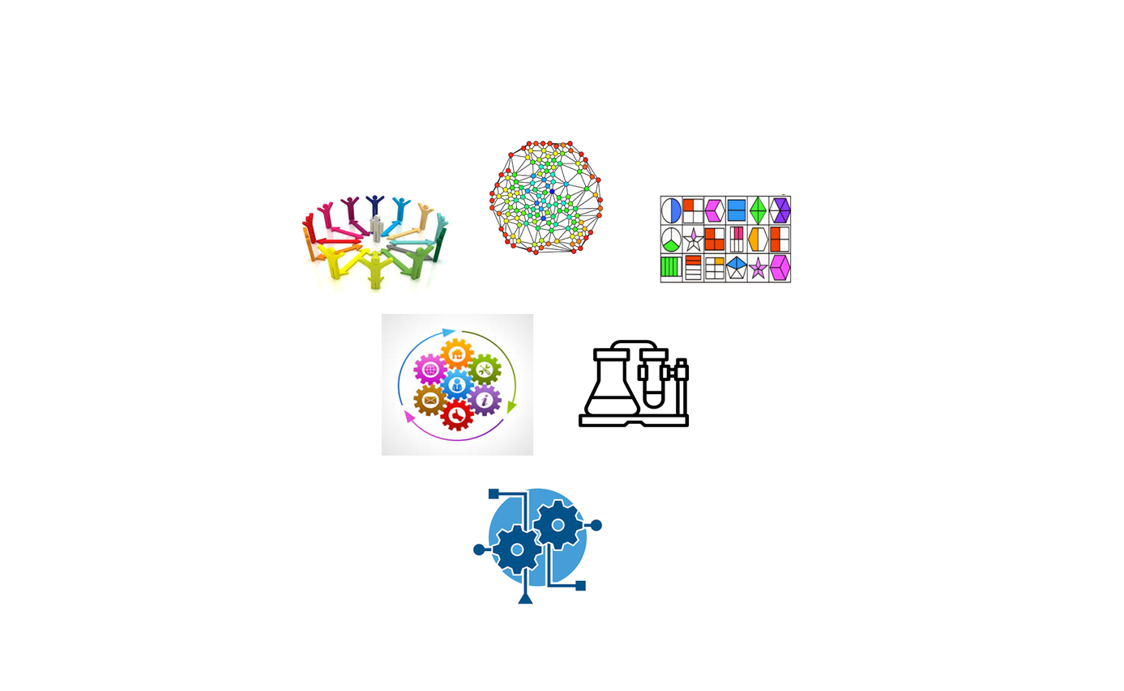
Background
How can we address this challenge?
Challenge: Systems engineering (SE) is evolving to address more complex systems, including SoS
Mission Engineering (ME)
The deliberate organization and integration of a system of systems (SoS) to achieve a particular goal or mission
using
Digital Engineering (DE)
Leverages a digital thread to manage the propagation of changes across the various models of a system and maintain consistency

Slide 4
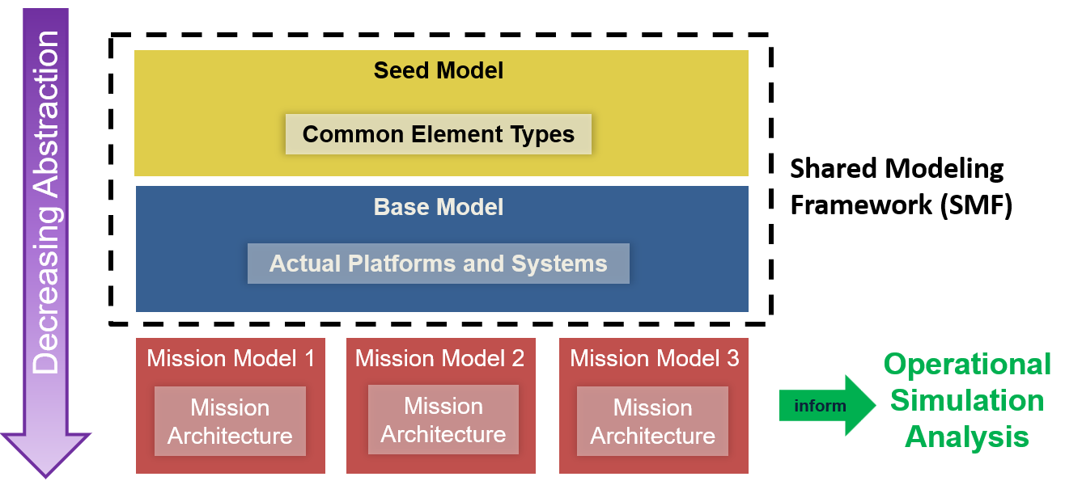
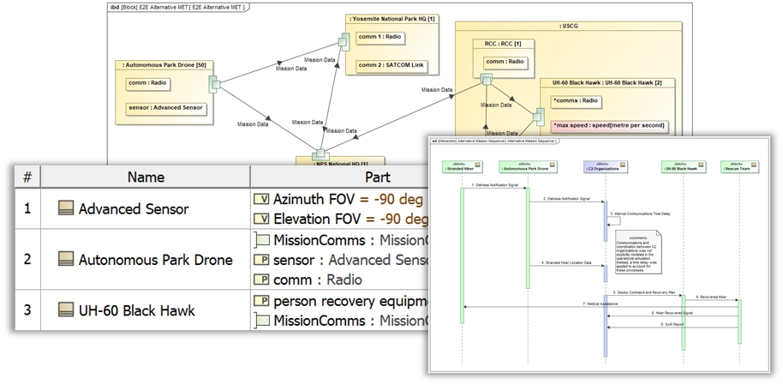
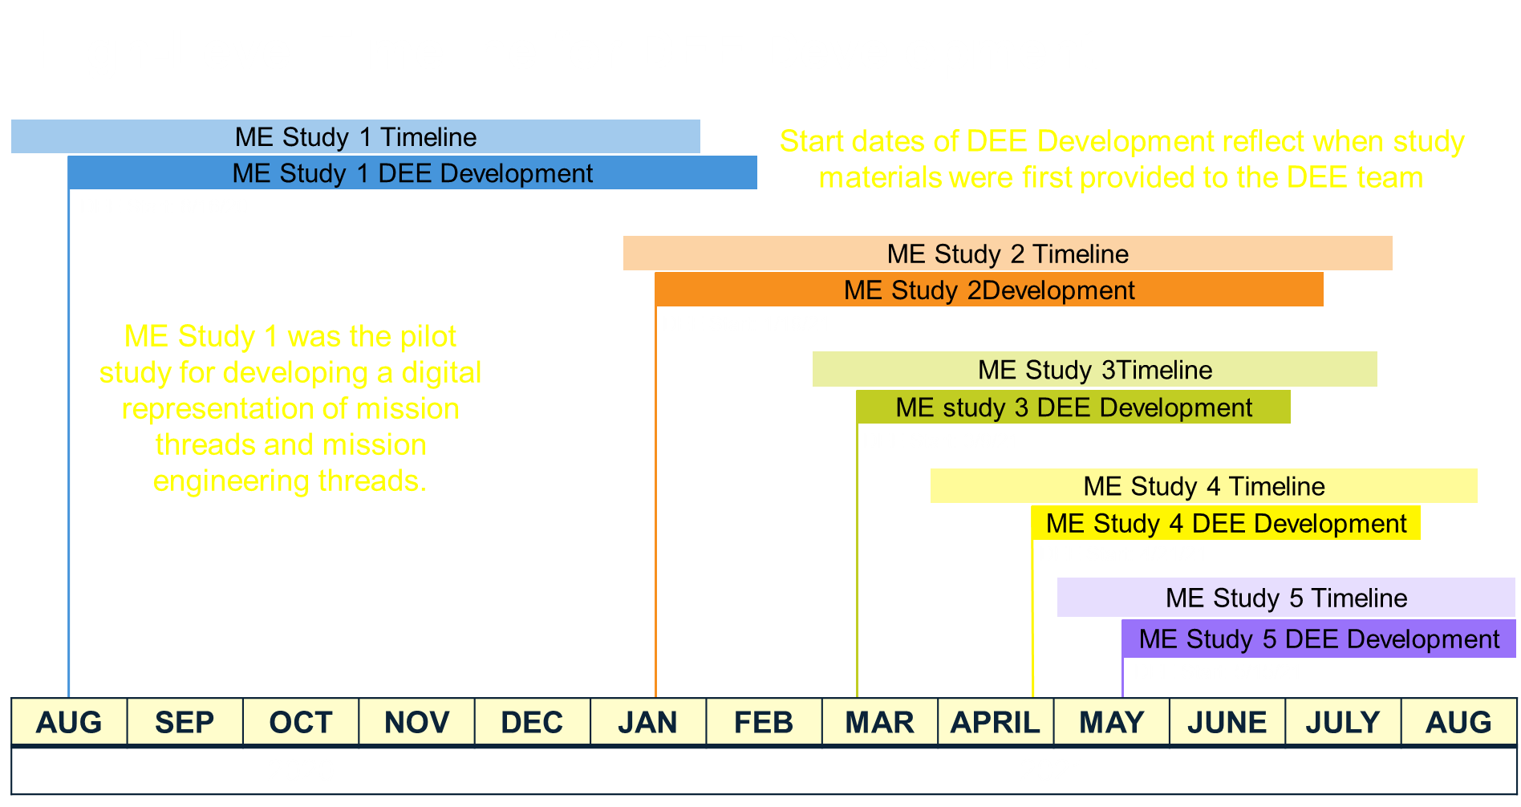
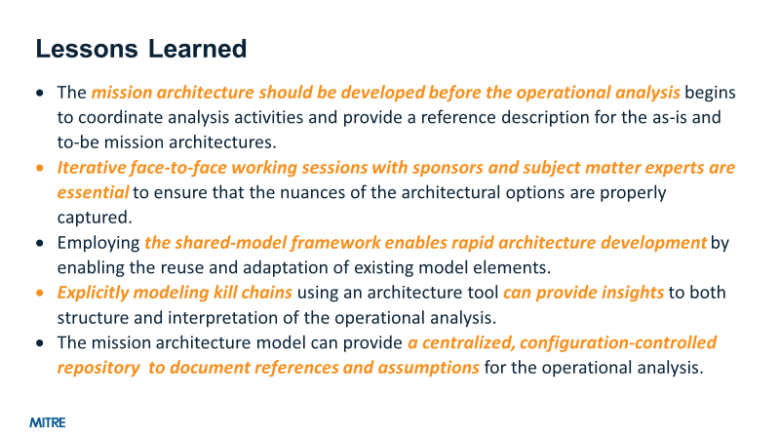
Approach
Needed to identify a set of stable architectural components that entail a reasonable level of tailoring over multiple, related applications
To accomplish this we…
  Populated the SMF over multiple ME studies
  Developed a re-usable and flexible Shared Modeling Framework (SMF) that anticipated that architectural components would evolve over time
  Tracked lessons learned and impacts on study execution

Slide 5
Shared Modeling Framework
The Shared Modeling Framework (SMF) is a set of SySML models developed in a Model-Based Systems Engineering (MBSE) tool for use in Mission Engineering Studies
Common Element Types (e.g. Air Platform, Radio, etc.) are defined in the Seed Model
Reusable model elements are maintained in the Base Model as building blocks for use in various Mission Models
Mission models use the Base Model and other data to address different ME studies
The mission models inform the operational simulation analysis
Seed Model
Common Element Types
Shared Modeling Framework (SMF)
Decreasing Abstraction
Base Model
Actual Platforms and Systems
Mission Model 1
Mission Model 2
Mission Model 3
Operational Simulation Analysis
Mission Architecture
Mission Architecture
Mission Architecture
inform
The digital nature of MBSE tools like Magic Systems of Systems Architect / Cameo / MagicDraw is key to enabling reuse in the Shared Modeling Framework
Objects (i.e., “Blocks” in SysML) and inheritance relationships are leveraged to reuse elements from the Seed and Base Models
The same Block can be instantiated in various mission architectures across different mission scenarios

Slide 6
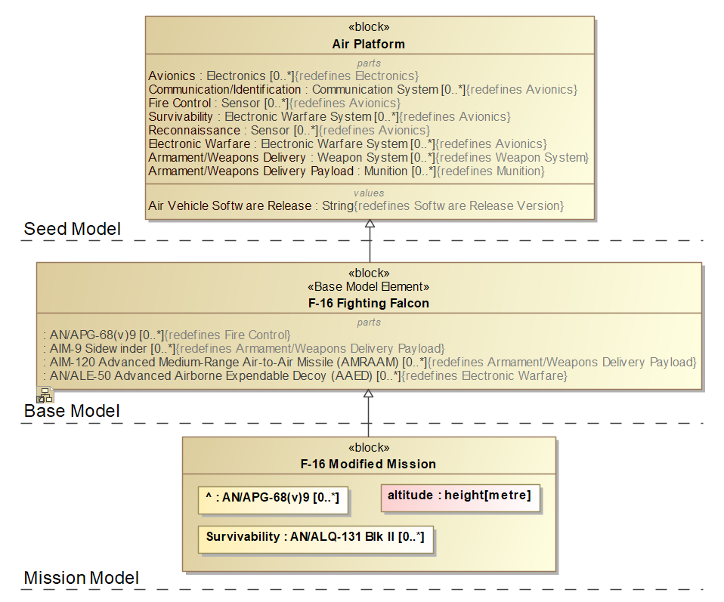
Reuse Systems from the Shared Modeling Framework
Seed Model – Element Classifier
Contains generic properties for a class of systems and serves as “blueprints.”
Base Model – Baseline System Definition
Specifies properties inherited from the Seed Model classifier for specific systems.
Properties are independent of scenario context.
Mission Model – Mission System Definition
Redefines properties inherited from the Base Model system to reflect changes for the scenario context.
Adds new properties as needed for the scenario context.

Slide 7






Benefits: Enabling Structure and Flexibility
Standard Containment Window Structure
Layered Architecture gives modelers flexibility
New system addition is not prohibitive
Built in SysML to also allow definition in other frameworks
Use across MITRE sponsors and projects
Network of Users

Slide 8
Current Update
Reusability is key to direction and speed
Sponsor list using DE for Mission Engineering is growing rapidly
In order to share the SMF more openly, an effort was undertaken to redefine the Seed and Base models using open unclassified standards
To expand the Seed and Base models:
  Remove AFSIM/CUI dependence via clean slate
  Leverage Open Standards
  Use similar MITRE ME model structure to what works for our use cases
Open Standards can provide:
Enumerations/ Lists of Systems
What is in a System
How a System can be categorized
However, Standards are not always 1-to-1 and require tailoring to fit our purposes

Slide 9
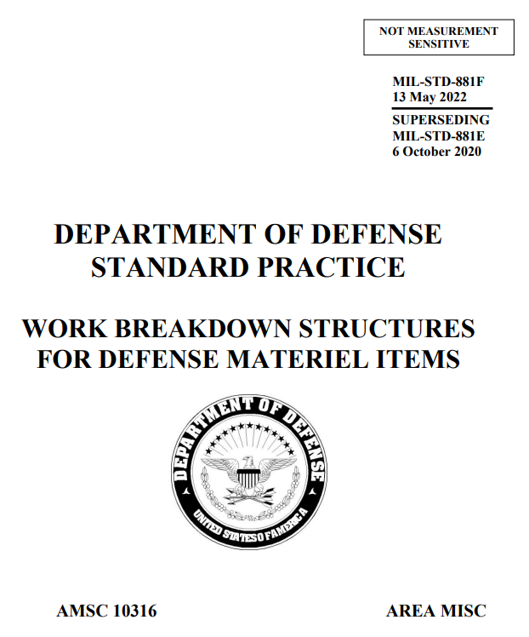
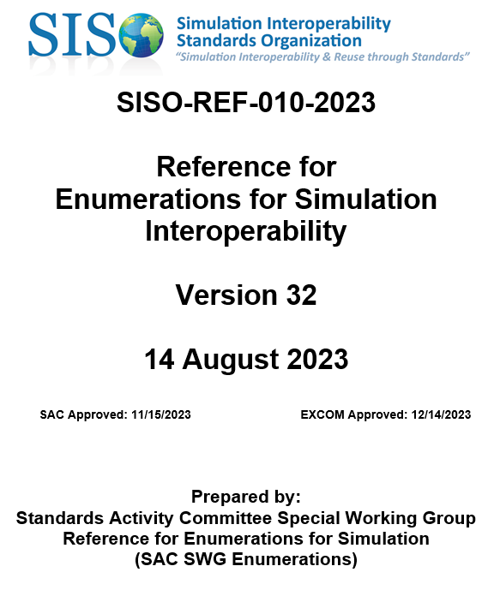
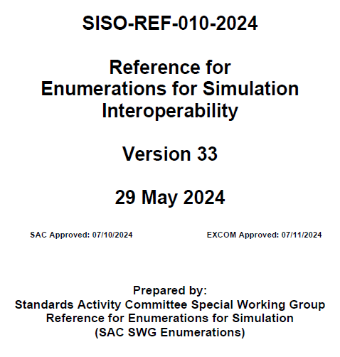
Leveraging Open Standards
In the Seed Model, system types were based on standards like:
MIL-STD-881 – framework for DoD Program Managers to define their program’s Work Breakdown Structure (WBS)
  Refined system parts for MITRE ME studies
SISO-REF-010 – enumerates systems for Distributed Interactive Simulation (DIS)
  Utilized many elements in Base Model and included some system types in Seed Model

Slide 10
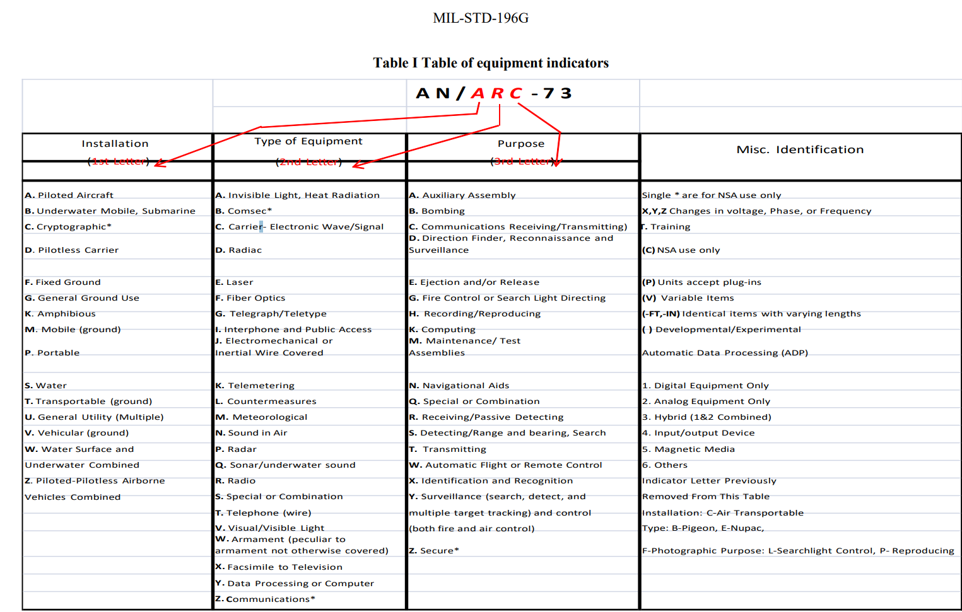
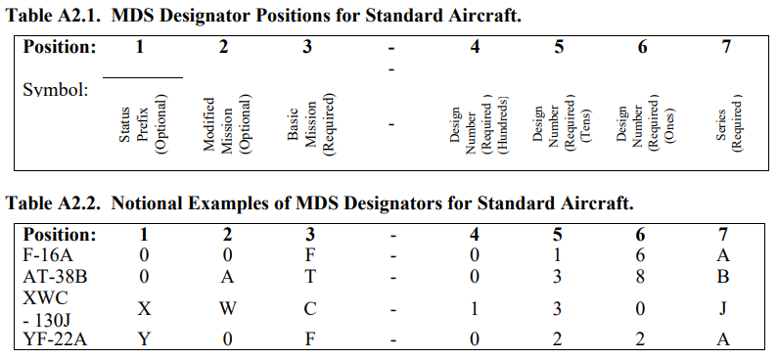
Leveraging Open Standards, cont.
Additional standards used for system definition include:
MIL-STD-196 – Joint Electronics Type Designation Automated System (JETDAS): nomenclature for electronic and associated equipment
DAFI 16-401 – Designating and Naming Defense Military Aerospace Vehicles
SECNAVIST 5030.8 – General Guidance for the Classification of Naval Vessels and Battle Force Ship Counting Procedures: how the US Navy designates its ships
DAF Instruction 16-401 / Army Reg 70-50 / NAVAIRINST 13100.16

Slide 11
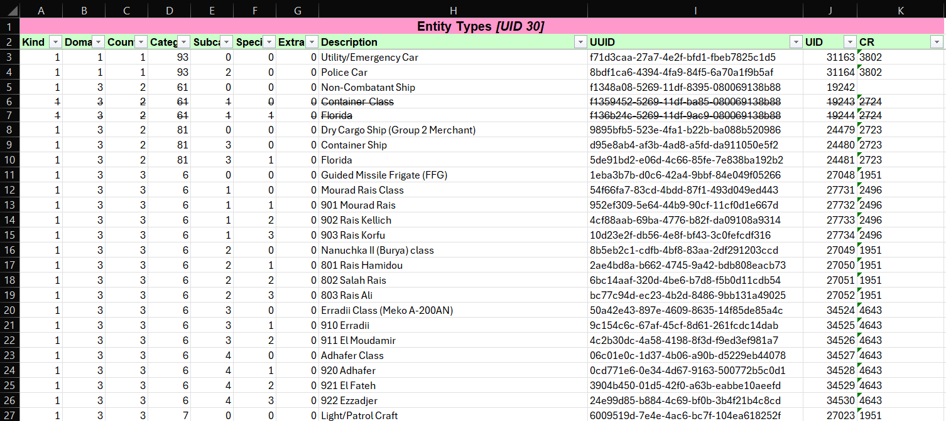
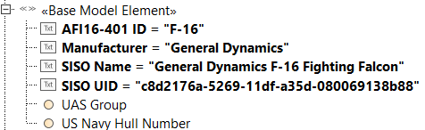
Updates to Shared Modeling Framework
SISO-REF-010 allow us to bring in a large list (1000s+) of systems with additional information about them
  Scoping and verification needed
Adding metadata fields to store tags for additional information – “Cameo Database”
  Metadata comes from aforementioned standards
Unique Identifiers (UIDs) should improve cross-tool coordination
25,000+ elements
in SISO-REF-010
Reprinted with permission from SISO Inc.
F-16 Fighting Falcon
F-16 Fighting Falcon
<<block>>
<<SimToolElement>>
UID = c8d2176a-…
UID = c8d2176a-…

Slide 12
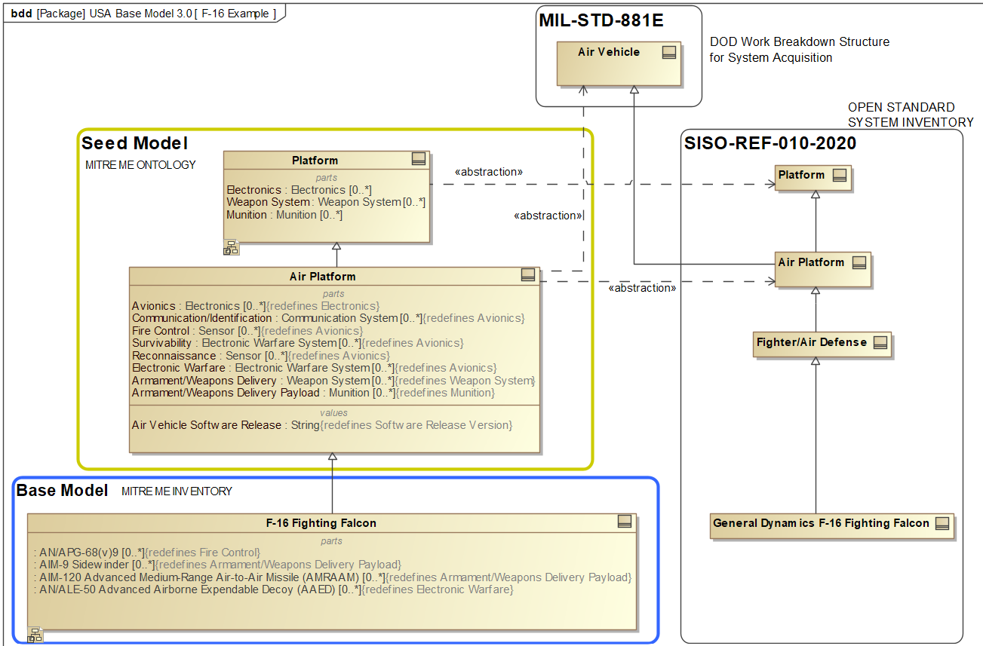
Example Metamodel and Relations
<<generalization>> relationship used for inheritance between model elements
<<abstraction>> relationship used to relate Seed Model elements to other Standards models
Base Model elements related to SISO model elements via unique identifier
Seed and Base Models can be used independently of other standards models
Redefinition of part properties allows for platform-specific Parts

Slide 13
Status and Next Steps
Shared Seed and Base Models amongst small group at MITRE to get in-depth technical feedback first
Continued development to build out common elements, use cases, and metadata
IP Disclosure and Public Release approved for sharing with Sponsors and external stakeholders
Configuration Management will be handled on GitHub with User Guide and example model available to public
GitHub will allow users to submit issues, enhancements, and questions, serving as central repository for managing feedback

Slide 14



Some Final Thoughts
Model reuse is never perfect and tailoring is usually required.
  The shared modeling framework reduces the amount of work required to construct a new architecture model. We are not anywhere near “plug and play.”
A good architecture provides the blueprint for operational analysis
  Precisely describes the starting conditions of the mission
  Helps everyone understand what is in the operational analysis
The framework and models can only get better with more use and feedback!!

Slide 15
Thank you for listening!
Any questions?
Paul Trevidic – ptrevidic@mitre.org
Michael Pennock – mpennock@mitre.org

